Slide 2

Patent Recommendation System
CMPE-256
Group 6
Submitted To:
Prof. Shih Yu Chang
Submitted by:
Amrita Kasaundhan
Arpit Sharma
Mahesh Reddy
Nidhi Kumar
Shivangi Nagpal

Slide 3
Objectives
Why do we need recommendation system for patents?
How does the system recommend relevant patents for you?
How do we collect patent data?
How do we compare the recommendation results?
Implement the machine learning models to build a recommender system.
GUI for recommender system.

Slide 4
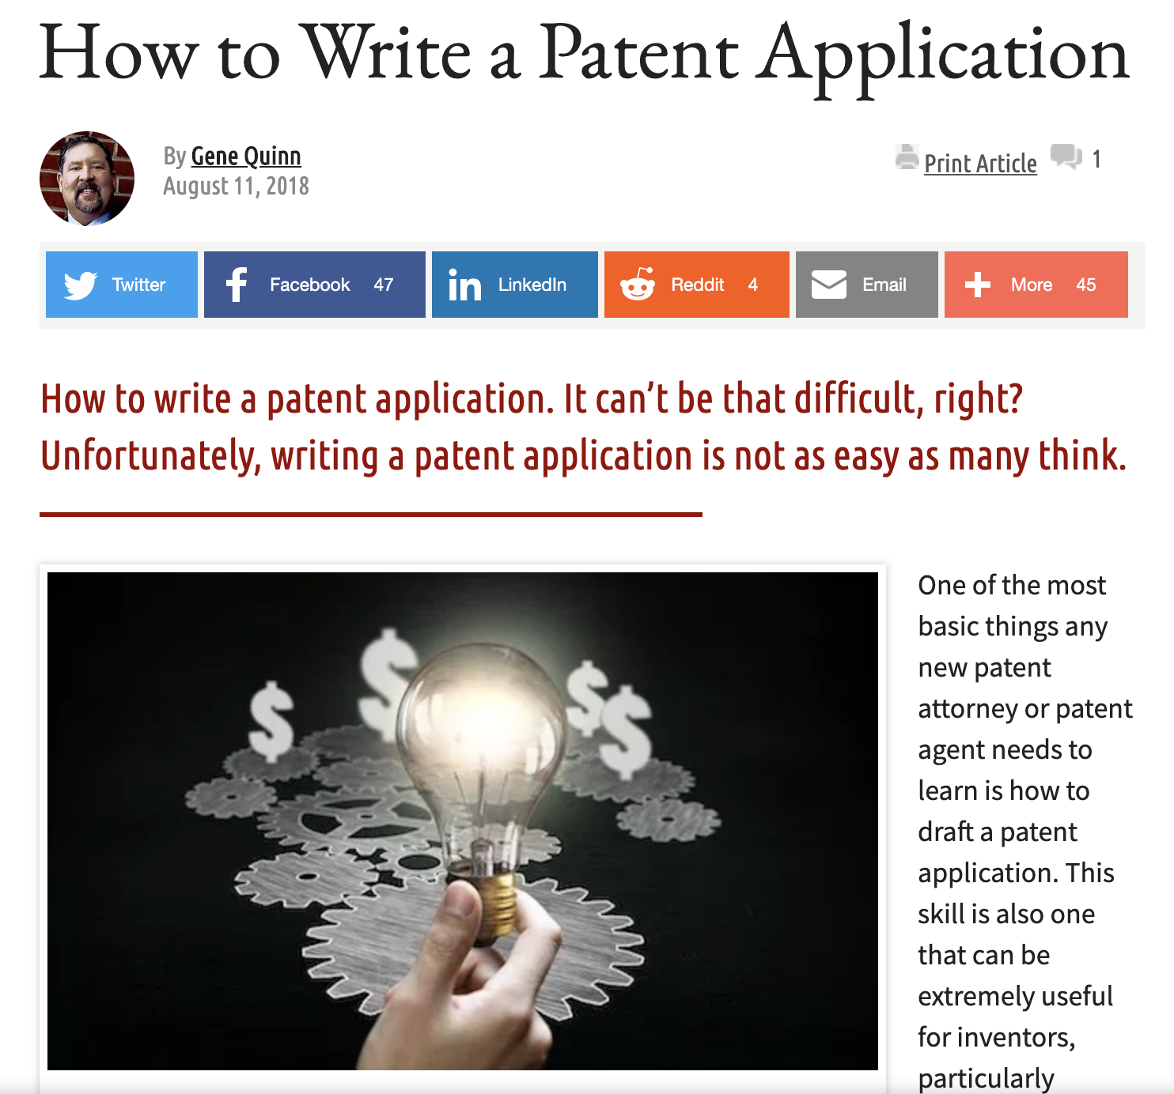

Slide 5
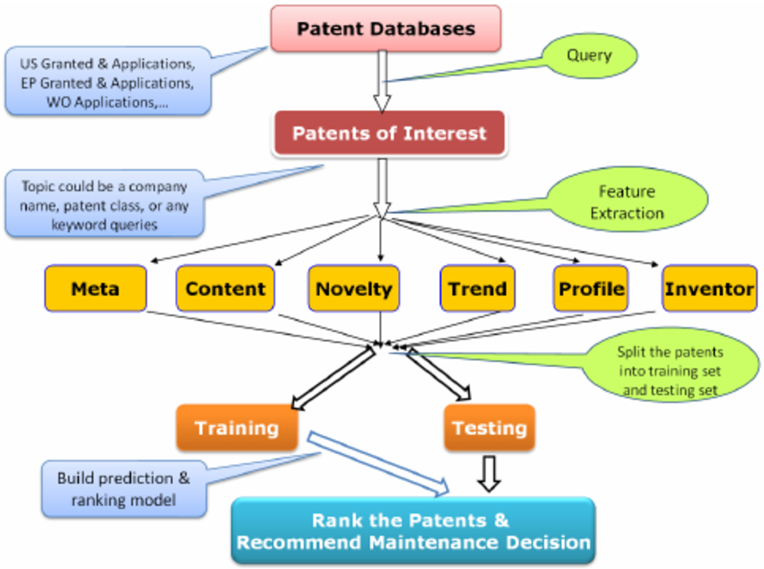

Slide 6
Data Extraction
Google Patents https://patents.google.com/
Title , Abstract, Inventors , Assignee, Classification, Patent Link
Application date, filing date, Grant date
Selenium Webdriver

Slide 7
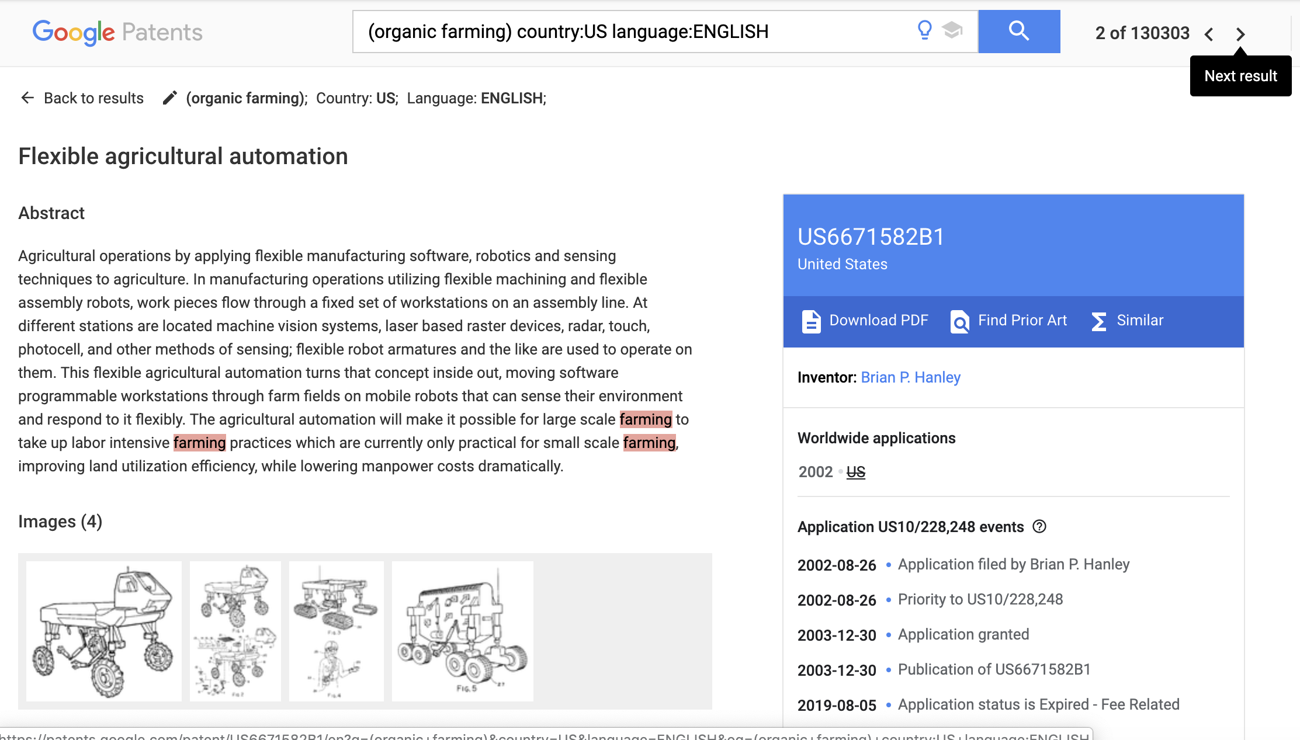
TITLE
PATENT NUMBER
Patent Number
TITLE

Slide 8
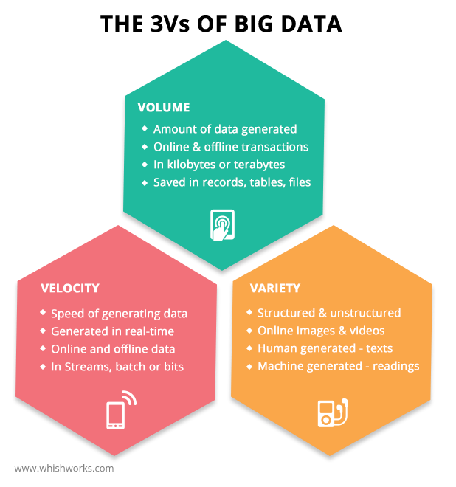

Slide 9
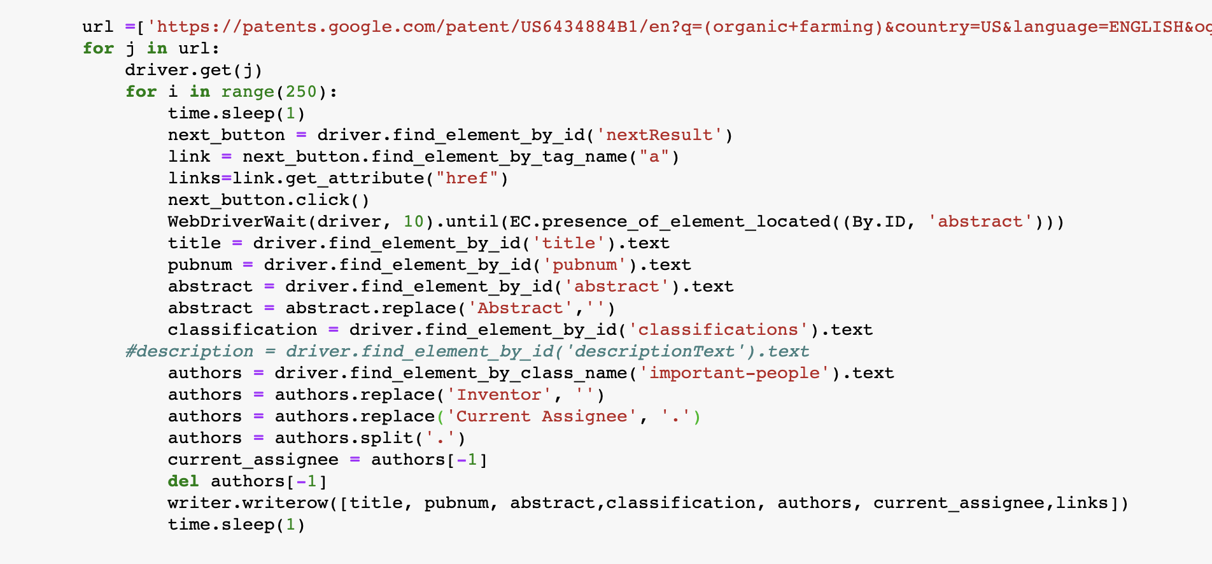
Looping Through Next page

Slide 10
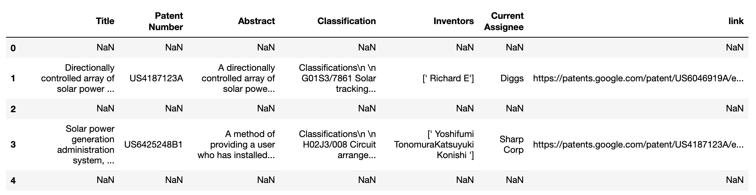
Data Cleaning
Before:
Notes:
Cleaned Rows with NAN values
Renumbered Row Numbers
Removed unnecessary new lines and word like classification

Slide 11
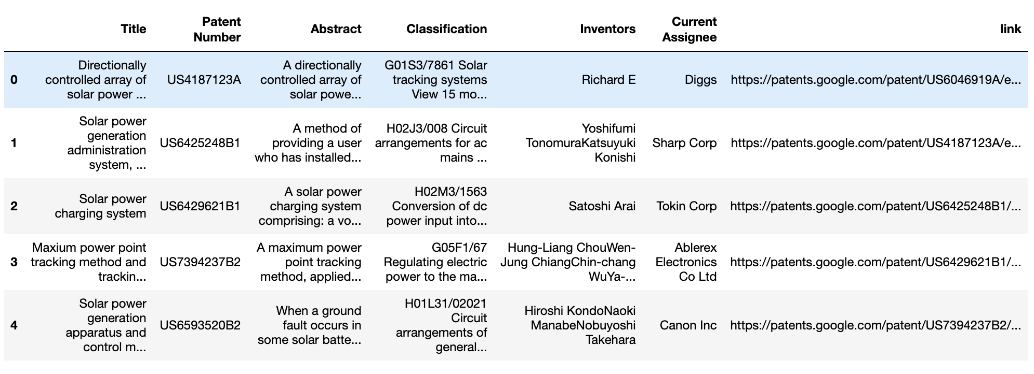
After:

Slide 12
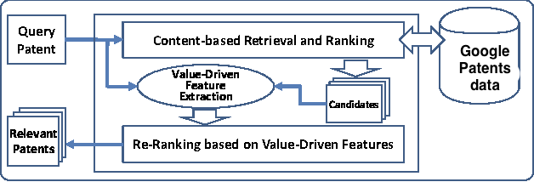
Content Based Filtering
The Content Based Recommendation Systems are born with the idea of using content of using each item for recommendation and try to solve the problem.
The content of an item is very abstract thing and gives us a lots of options. We can use a lots of different variables. For Example: for a patent we can consider title, patent number, classification, link, inventor etc.
When we know the content we will consider, we need to transform all this data into vector space model.

Slide 13
Similarity Calculation
Euclidean Distance
2. Cosine Similarity
3. Pearson Correlation

Slide 14
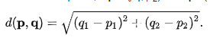
Euclidean Distance
It is used to calculate the linear distance between two variables in space.
Formula for 2-d space:

Slide 15
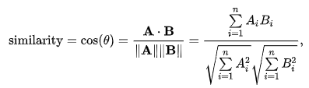
Cosine Similarity
It is a measure of similarity between two nonzero vectors of an inner product space that measures cosine of angle between them.

Slide 16
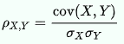
Pearson Correlation
It is a measure of linear correlation between two vectors whose value range from -1 to 1.
Formula:

Slide 17
Models Used
TF-IDF
Term Frequency- Inverse Document Frequency
LDA
Latent Dirichlet Allocation

Slide 18
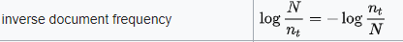
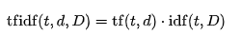
TF-IDF
Term Frequency: It is the numbers of times a keyword appears in the document.
Inverse Document Frequency:It is factor to reduce the weight of most commonly used word in all documents.
The value of tf-idf calculation will always be greater than or equal to 0
Notes:
TF(t) = (Number of times term t appears in a document) / (Total number of terms in the document).
IDF(t) = log_e(Total number of documents / Number of documents with term t in it).

Slide 19
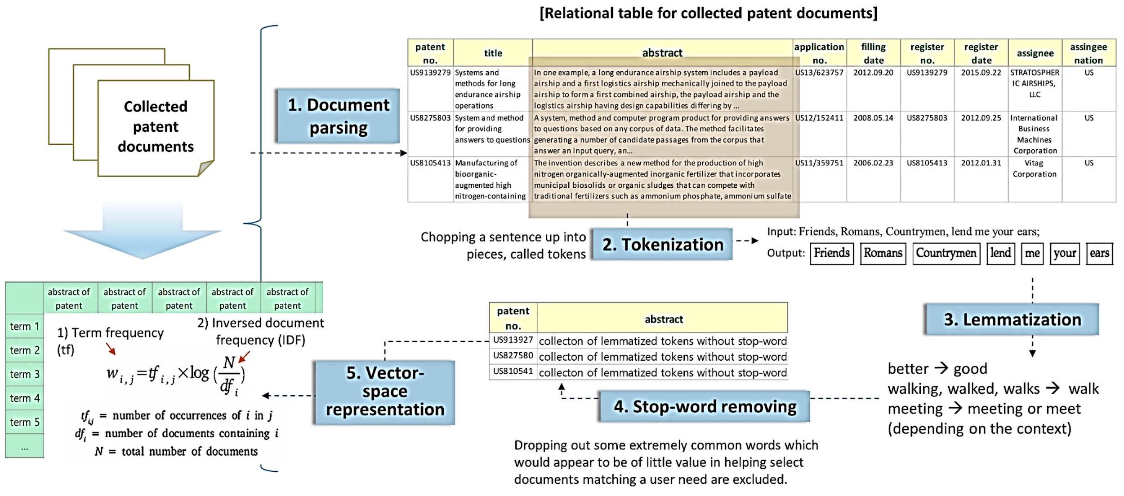

Slide 20
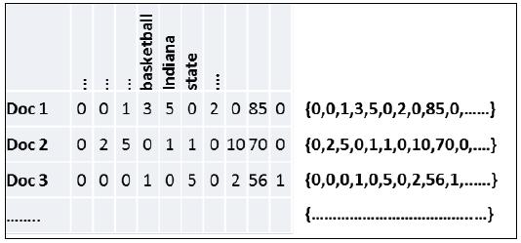
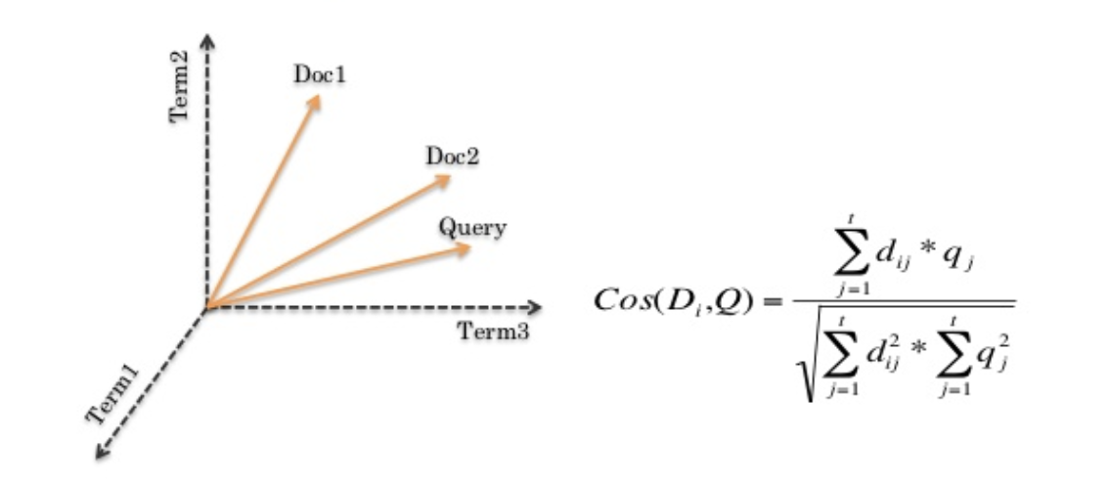

Slide 21
LDA- LATENT DIRICHLET ALLOCATION
LDA is a Topic Modeling Algorithm - represents documents as a mixture of topics.
Each document is modeled as a finite mixture over an underlying set of topics.
These number of topics learn the topic distribution that each document in a collection of documents has.
Notes:
LDA Topic Modeling Algorithm.
Treats documents as mixture of topics.
LDA will go through each of the words in each of the documents, and it will randomly assign the word to one of the K topics.
We will have topic representations (how the words are distributed in each topic) and documents represented in terms of topics

Slide 22
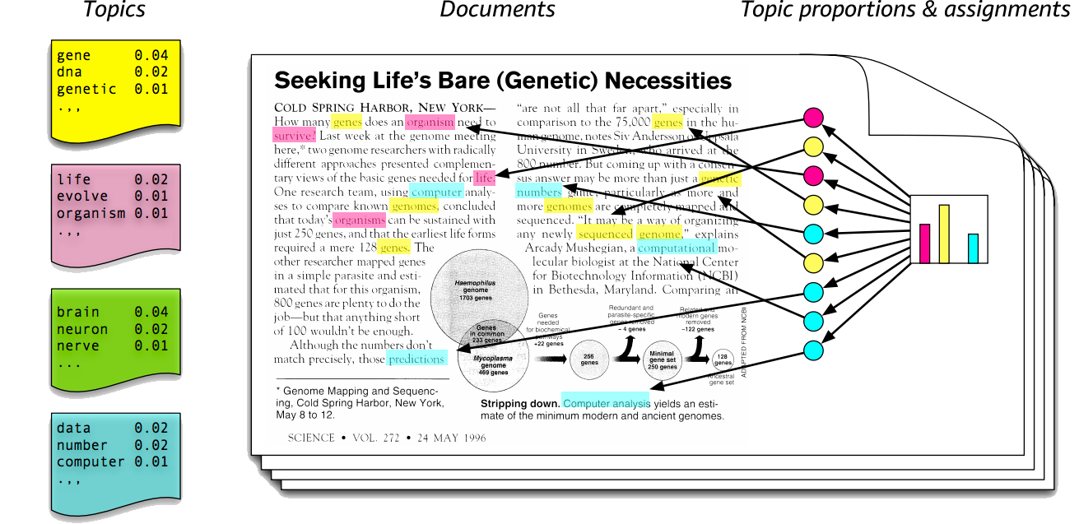
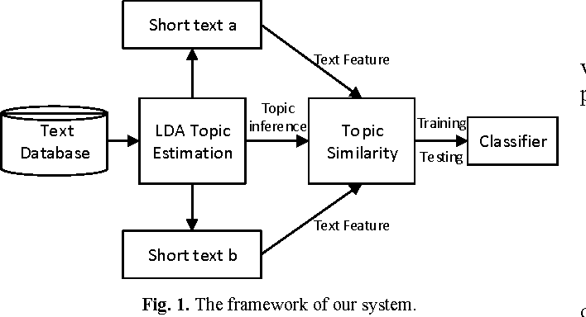

Slide 23
LDA Topic Modeling
A:I spend the day at the beach tanning.
B:I ate Mexican Tacos and Guacamole.
C:I love tanning in Mexican beaches while eating quesadillas and tacos under the sun.
Results:
Sentence A is 100% about Topic 1
Sentence B is 100% Topic 2
Sentence C is 30% Topic 1, 70% Topic 2
Topic 1: 30% beach, 15% tanning, 10% sun, …
Topic 2: 40% Mexican, 10% Tacos, 10% Guacamole, 10% Quesadilla.
Notes:
The assignment of words to topics, was done in a random form, so representation is not very optimal or accurate.
To better this representation LDA will analyze per document:
What is the percentage of words within the document that were assigned to a particular topic?
And for each word in the document, LDA will analyze over all the documents, what is the percentage of times that particular word has been assigned to a particular topic. LDA will therefore be calculating:
1) p(topic t | document d) = percentage of words in a document d that are currently assigned to topic t.
2) p(word w | topic t) = percentage of times the word w was assigned to topic t over all documents.

Slide 24
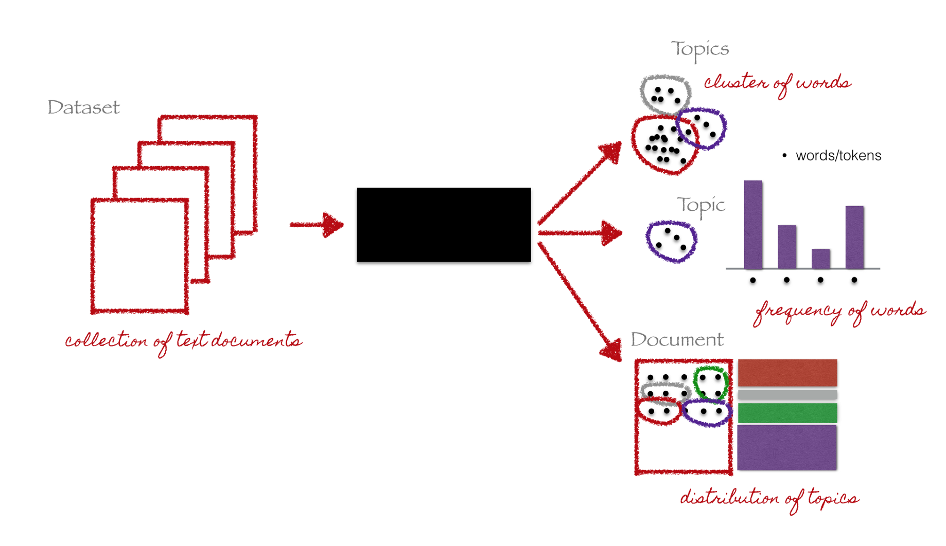
LDA

Slide 25
TF-IDF vs LDA
TF-IDF is at word level that measure how important a word is to a document and is used by weighting factor to frequency of a word. | LDA allows set of observations to be explained by unobserved groups that explains why some part of data is similar.

Slide 26
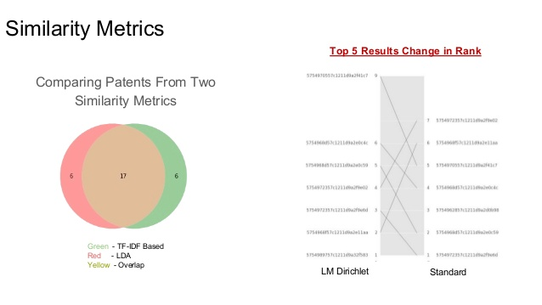
Similarity

Slide 27
Improvement & Correction
Patents with same title and different patent number?
Ex: Jacobs Jr., William R. US patents:
6300061 =>Mycobacterial species-specific reporter mycobacteriophages.
6225066 => Mycobacterial species-specific reporter mycobacteriophages.
When user searches for Patents he means content (NOT JUST TITLE)
Create new column CONTENT (combined from TITLE & ABSTRACT)

Slide 28
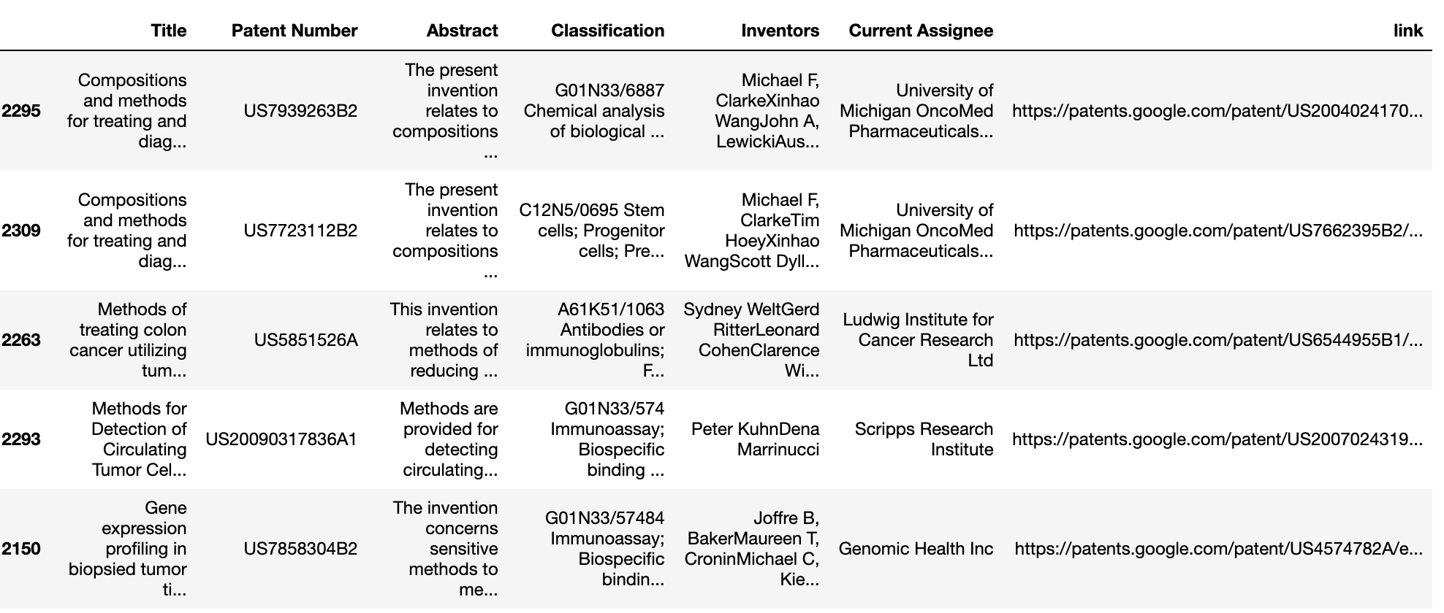
Results

Slide 29
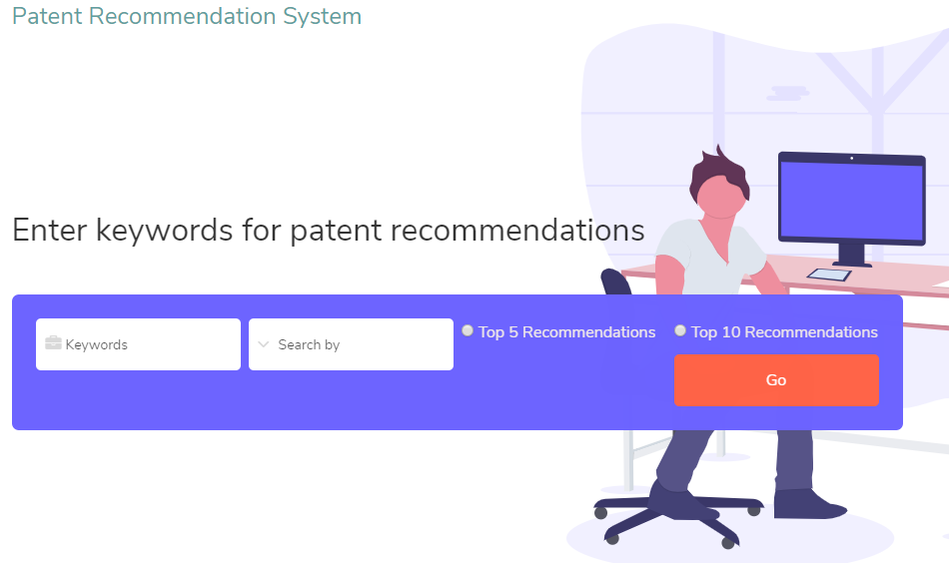
GUI-Front End
URL: www.arpsharma.com

Slide 30
Demo of Patent Recommendation System

Slide 31
Thank you

